Slide 1
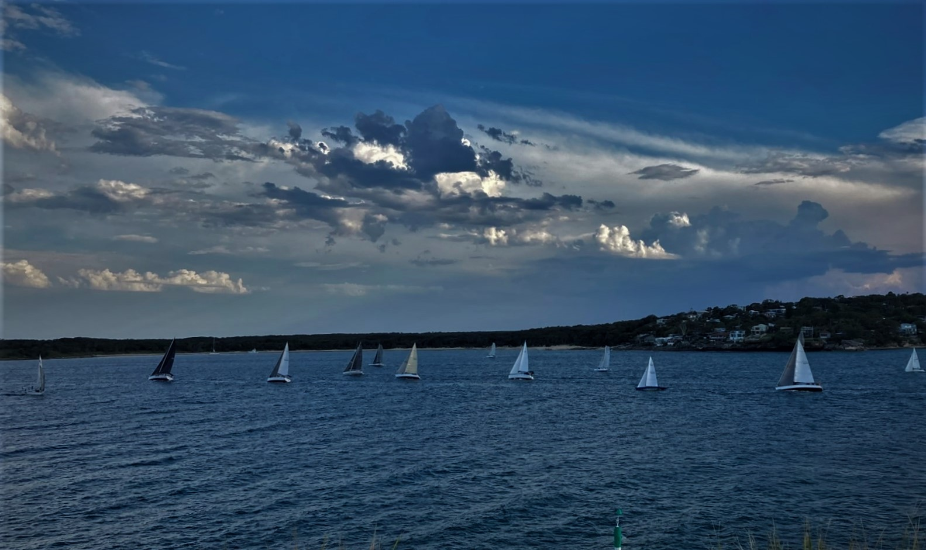
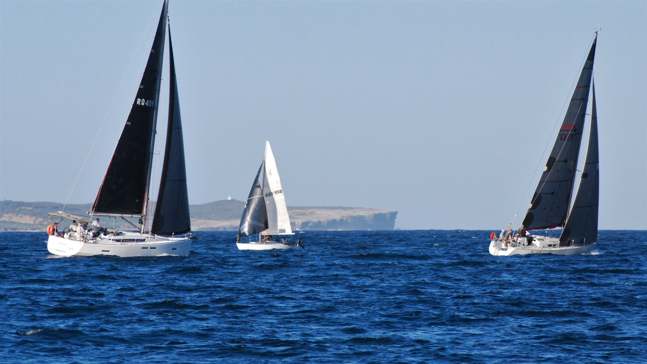

Sailing Captain’s
“Report 2024-25”
Race Entries:
Wednesday afternoons 15
Wednesday Twilight 21
Sunday Racing 13
Membership
Members 135
New Boats (welcome)
Mach 1 (Bavaria Match 38) – replaces Majella - David Cartmer
Axiom - Jeanneau 409 – replaces Inception - Andy Chilton
Patrol Boat - replaces Pied Piper - Tony Towndrow,
- Glen Burgess
1

Slide 2
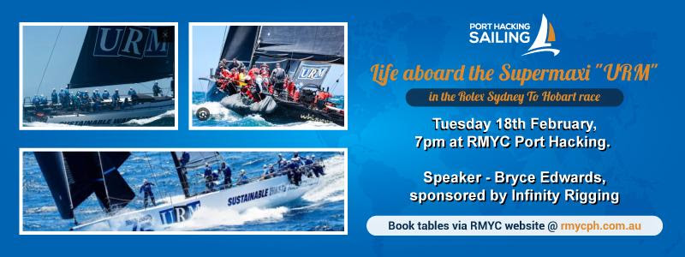
“Southern Queensland Cruising”- November
Speaker - Alistair Rowe; marri nuwi
Off & On Water Activities- Presentations
Off & On Water Activities
Life aboard URM- February Speaker -Bryce Edwards-
2

Slide 3
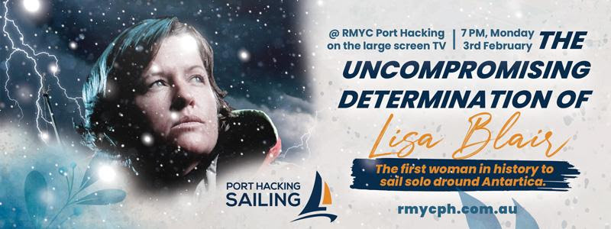
Lisa Blair Movie night
Off & On Water Activities- Presentations
Off & On Water Activities
3

Slide 4
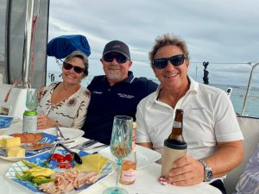
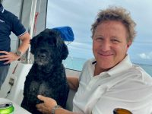
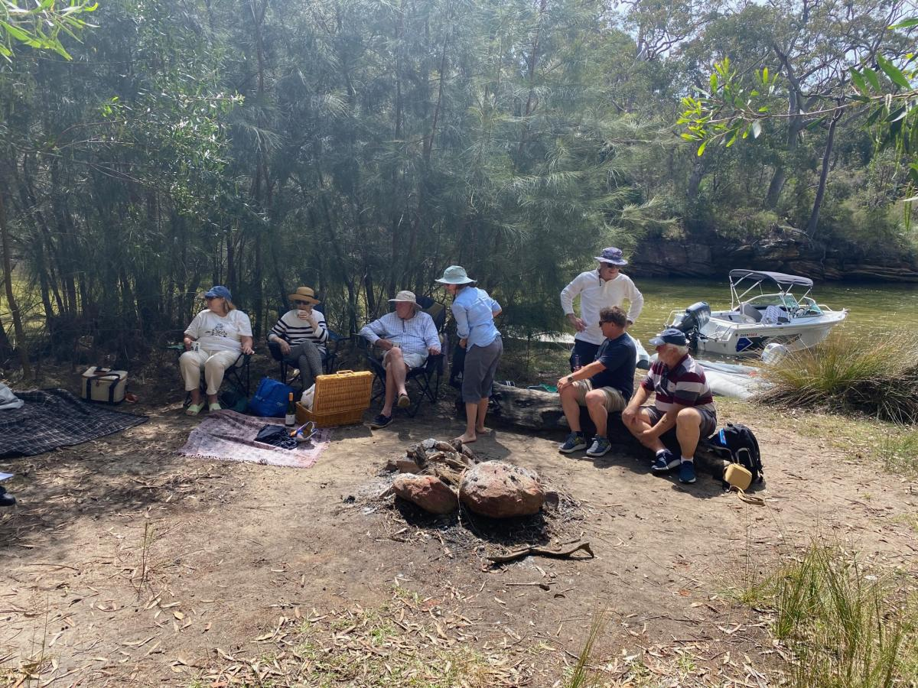
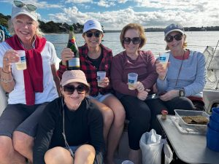
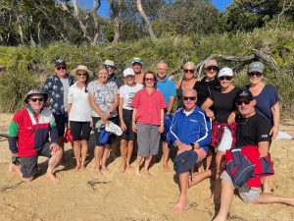
Off & On Water Activities- Cruising
Wildflowers October 2024 – A slice of Heaven Lunch at Boat Harbour
Wattamolla - ‘The Shift in the Wind’
4

Slide 5
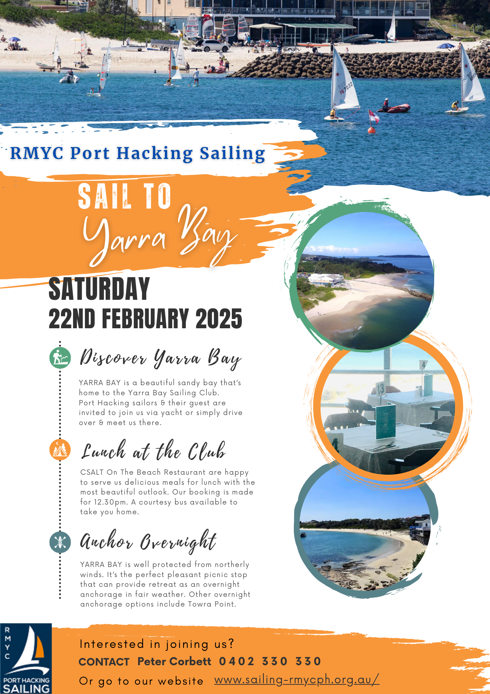
Off & On Water Activities- Cruising
Whale Watching
By Peter Corbett
Reve leads us out of Jibbon as the red ensign proudly dances in her wake.
I followed next in Navigator, with her dew covered decks reflecting the cool bright morning sunshine. Mach1 follows fast, close astern. There was little swell to bother us but the chill of winter breeze.
Bill Dickson heads us towards the small grey silhouettes sitting on Bate Bay’s horizon. We all follow.
These grey oscillating cubes come into profile finally forming recognisable features of three other boats.
We are all here for the same reason

Slide 6
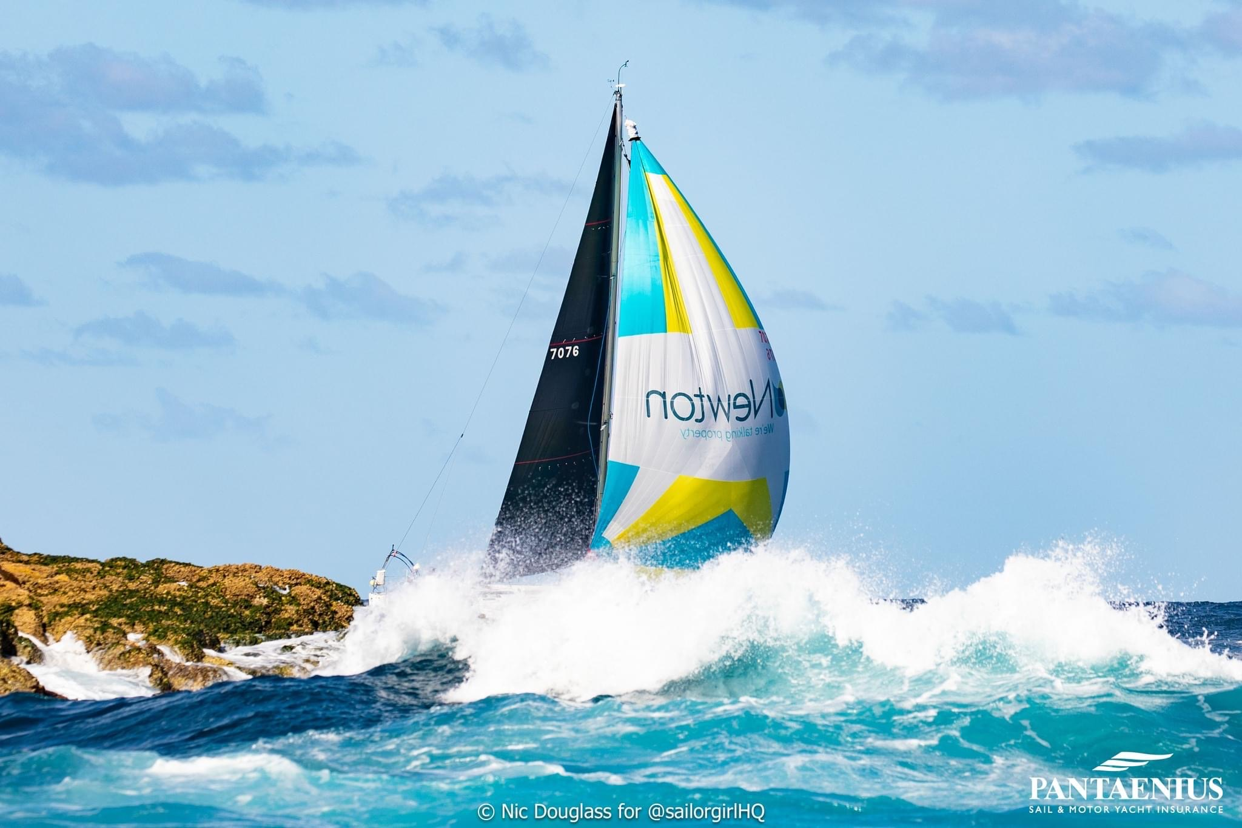
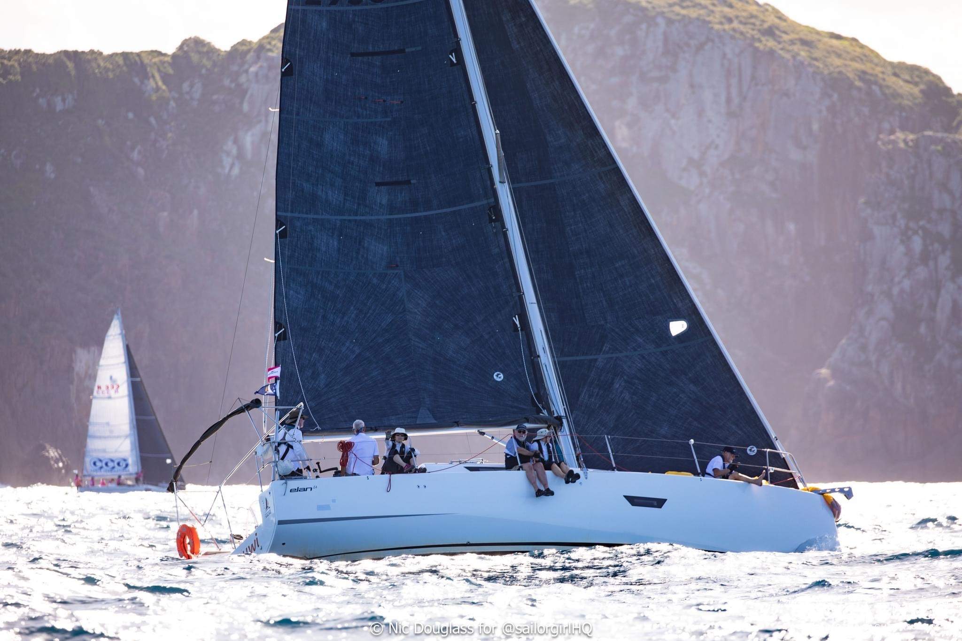
Port Stephens regatta
Yknot- sailed in Division 2
Jazz Bar- sailed in Division 2
Marri Nuwi- sailed in Division 4
Mach 1 – sailed in Division 4
6

Slide 7
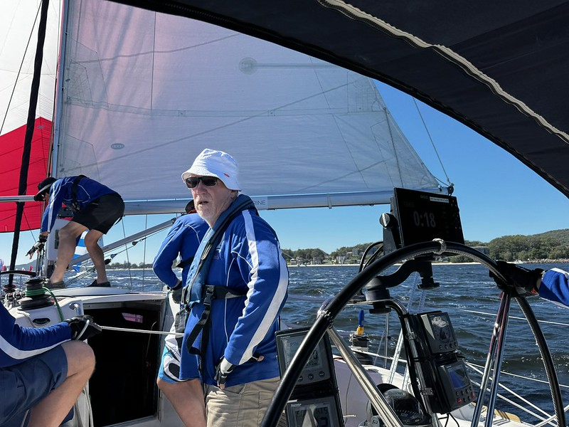
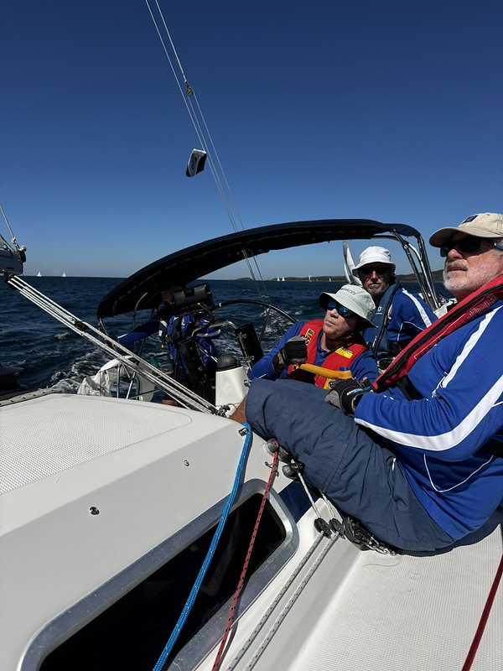
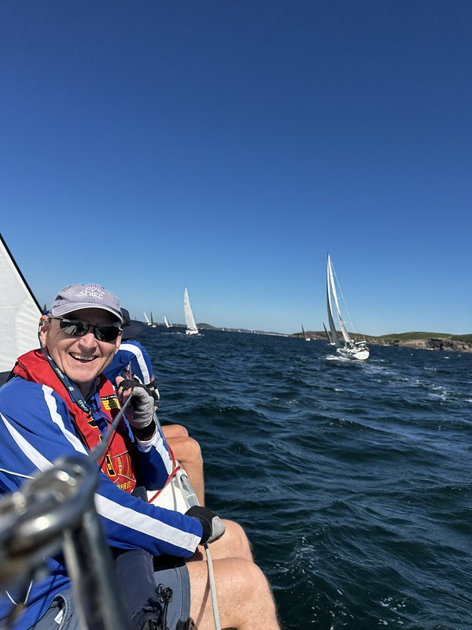
Port Stephens regatta
7

Slide 8
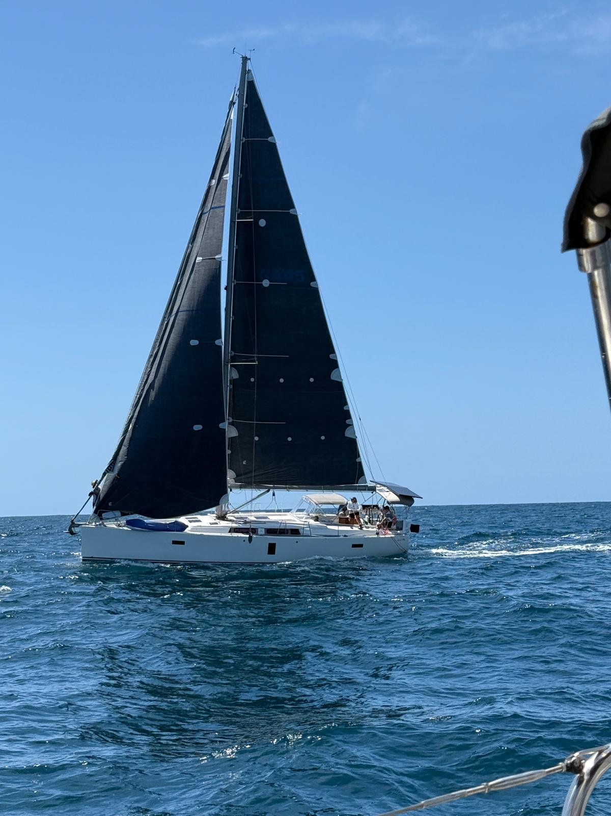
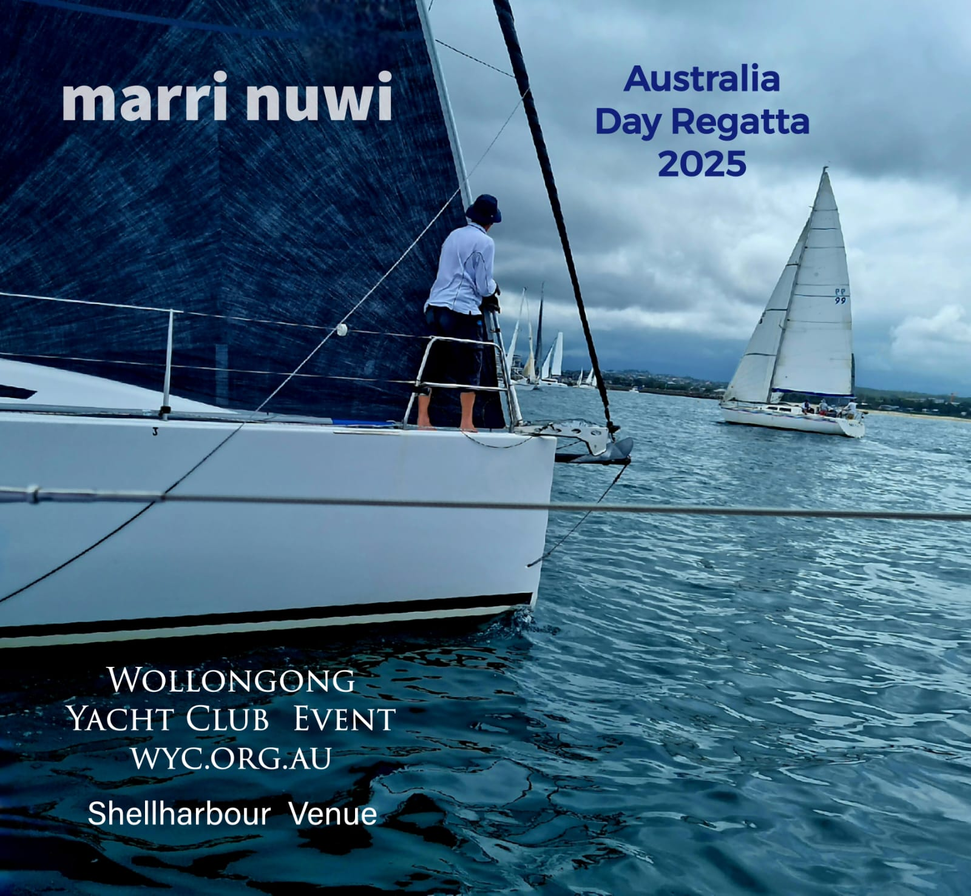
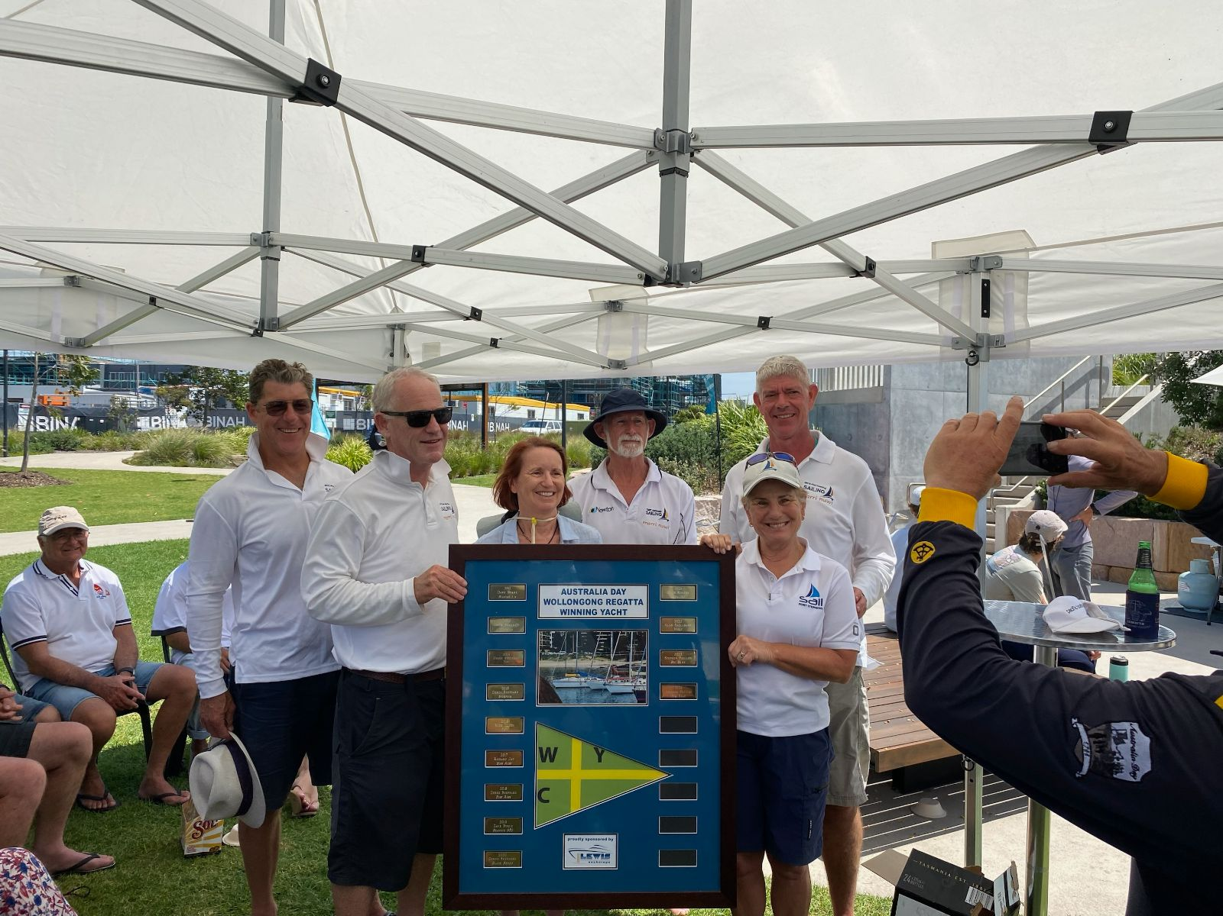
Wollongong/Shellcove Regatta- 3 Days,7 races- January
Marri Nuwi- 1st Place
Etre Jeune – 2nd Place
16 entries
8

Slide 9
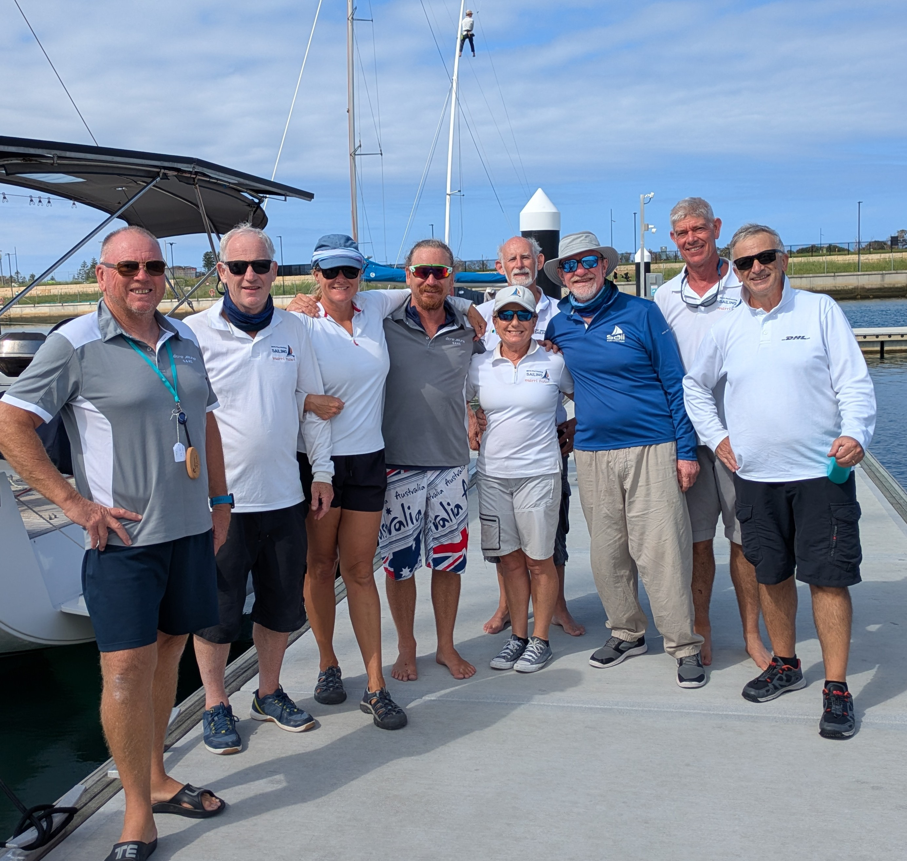
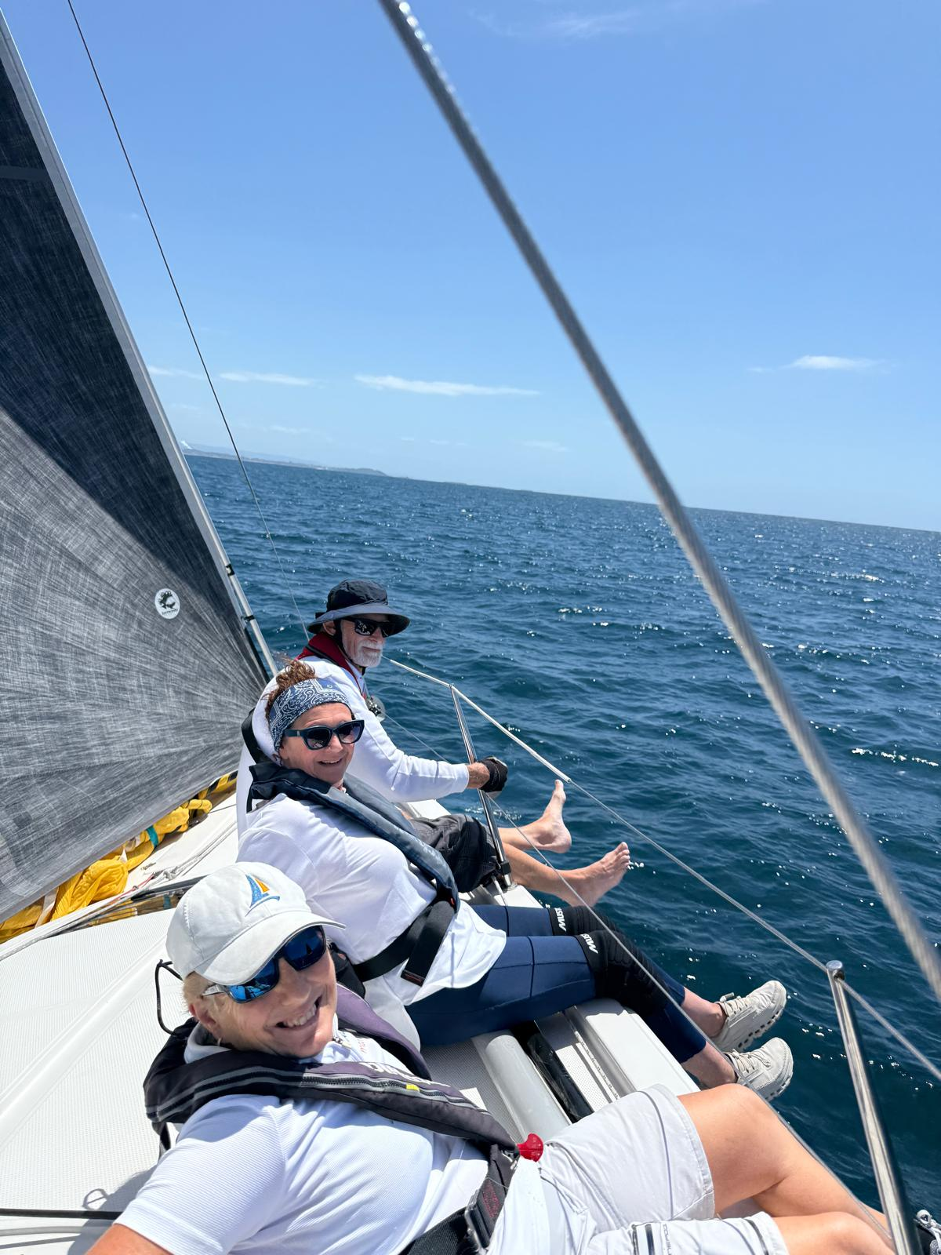
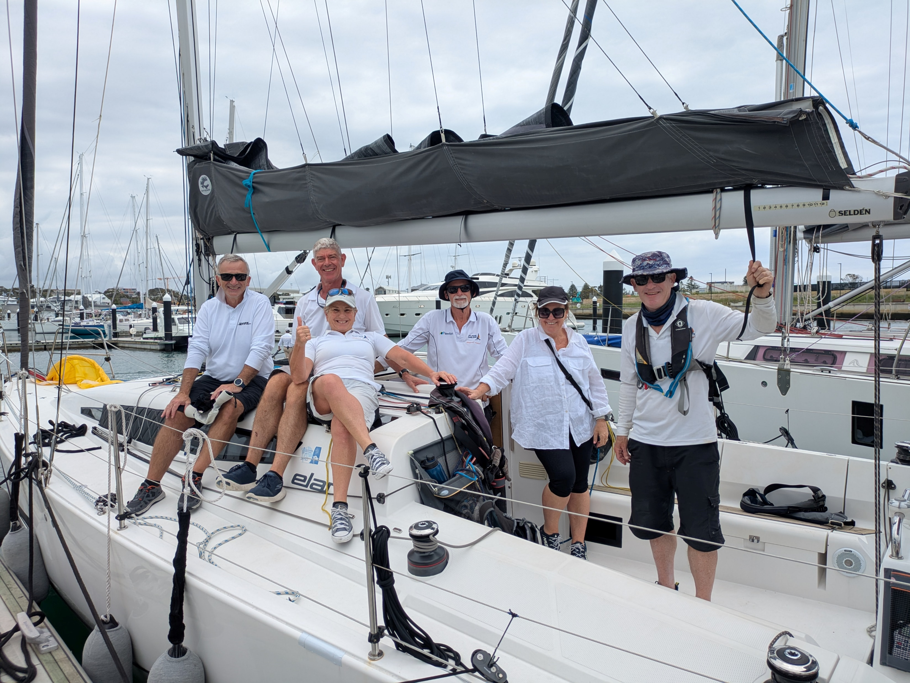
Wollongong/Shellcove Regatta- 3 Days,7 races- January
9

Slide 10
Thankyou
The successful year of sailing, could’nt have happened without the help of our committee, volunteers, skippers, crew, and sponsors.
Committee members - John Barter Vice Captain, and race officer
- Tim Dodds – Treasurer
- Bill Dixon – Safety
- Peter Corbett- Cruising
- Jared Macquart- Liason with Cronulla Sailing Club
- Glen Burgess- Secretary
Volunteers - Ken Teifel; Wednesday Twilight presos
- David Newton, Tim Dodds; Presentation night & Xmas party
- Pete Corbett, Nick Wilson, Brett Parr; Wednesday courses
- Mike Wolf, Rob Milner, Glen Smith,; Auditors
Alistair Rowe
Sailing Captain 2024/25

